Slide 1
Malta 4-Day Work Week
Impact Study
A Synthetic Travel Demand Simulation
Data: NSO National Household Travel Survey 2021 | 4 Day Week Global – Portugal Trial

Slide 2
Problem & Aim
84%
€118M
42%
of Malta's trips
by personal vehicle
annual cost of
congestion in Malta
of all trips are
commuting trips
Research Aim
Model the transport impact of a four-day working week in Malta using a synthetic travel demand simulation grounded in real NSO survey data, without conducting a new primary survey.
Two scenarios compared: 5-Day Baseline vs 4-Day Week

Slide 3
Data Sources
NSO Household Travel Survey 2021
4 Day Week Global – Portugal Trial
31 statistical tables encoded as probability arrays
41 companies, 1,000+ workers over 6 months
10 charts covering mode, purpose and timing
Activity uplifts calibrate day-off behaviour
6 districts and 67 localities across Malta & Gozo
Recreation uplift: +0.22
Origin-destination matrix (6x6 district level)
Visiting family & friends uplift: +0.42
Mode split by purpose, labour status, age, gender
Shopping uplift: +0.14
Bus, parking and vehicle ownership statistics
3 locality CSVs: population, POI counts, regions
Tables 27-30 excluded (Covid-19 distorted data)
Commuting set to zero for day-off workers

Slide 4
System Architecture
paths.py
syndata.py
4_day.py
gui.py
Centralised file
path management
Probability arrays
& baseline generation
4-day week scenario
derivation logic
Streamlit dashboard
& visualisation
NSO Data + CSV files
100,000 synthetic trips
4-Day week dataset
Interactive comparison
Key design decision: Seeded RNG (seed=42) ensures full reproducibility across all runs

Slide 5
Baseline Trip Generation
Each of the 100,000 trips is built by sampling a chain of conditional probability distributions:
1
2
3
4
5
6
Labour
Status
Trip
Purpose
Transport
Mode
Time
of Day
Origin
District
Destination
& Locality
Employed, Student,
Retired, etc.
Conditional on
labour status
Conditional on
trip purpose
8 bins from
00:00–23:59
Weighted by
trip volumes
OD matrix +
POI weighting
Two-tier geographic precision:
District level (6x6 OD matrix from NSO Table 8) → Locality level (population-weighted origins, POI-weighted destinations)
Realism constraints: Retired, Unemployed, Students, Homemakers & Cannot Work are all forbidden from Commuting

Slide 6
4-Day Week Scenario Logic
Baseline Employed Trips
Still Working
Day Off
(trip retention %)
(1 - retention %)
Trips kept completely unchanged
Commuting preserved as-is
Purposes redistributed using
Portugal uplifts — Commuting = 0
Mode, time & destination resampled
Non-employed trips (Student, Retired, Homemaker, Cannot Work, Unemployed) pass through completely unchanged
Example at 0.50 retention: 50% still commuting | 50% on day off making leisure trips

Slide 7
Interactive Dashboard (Streamlit)
Simulation Controls
Dashboard Tabs
Trips Generated
Scenario Comparison
10,000 – 200,000 baseline trips
Mode, purpose, traffic clock, busiest localities
Trip Retention Rate
Fraction of employed still working (0.10 – 1.00)
5-Day Baseline
Heatmap, locality bars, mode pie, purpose split
Random Seed
Ensures identical reproducible outputs
4-Day Week
Save CSV
Heatmap, locality bars, mode pie, purpose split
Export both datasets for external reuse
Choropleth heatmap rendered from QGIS GeoPackage, parsed in pure Python (sqlite3 + struct), no external GIS dependency required

Slide 8
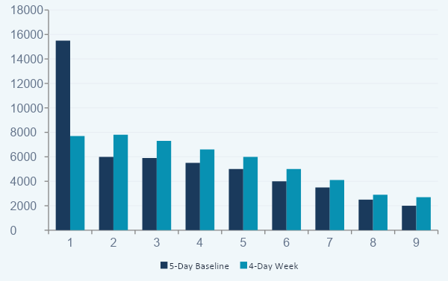
Results: Purpose & Mode Shift
50,000 trips | Seed: 42 | Trip retention: 0.50
−50%
Commuting drops
at 0.50 retention
+30%
Recreation rises
to top purpose
~Even
All purposes become
more balanced

Slide 9
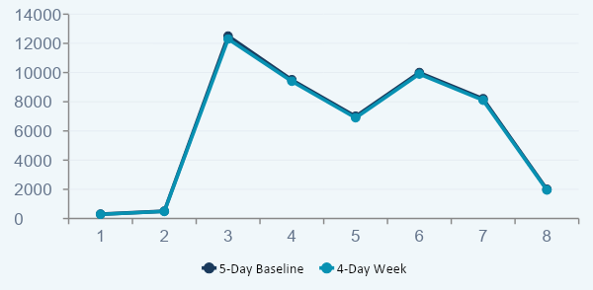
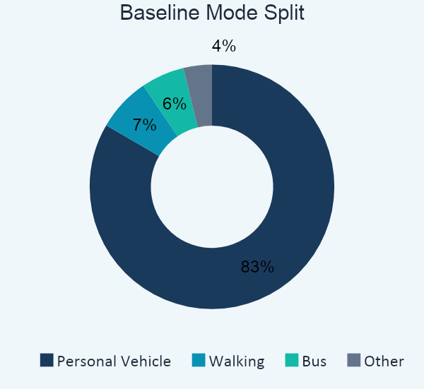
Results: Mode Split & Hourly Volume
Morning Peak Unchanged
Car Dependency Persists
Despite removing 50% of commuting trips, the 06:00-08:59 peak remains near-identical. Leisure trips fill the same time slots.
Vehicle share drops only 1.4% (83.4% to 82%). Walking and bus use increase marginally. Car remains overwhelmingly dominant.

Slide 10
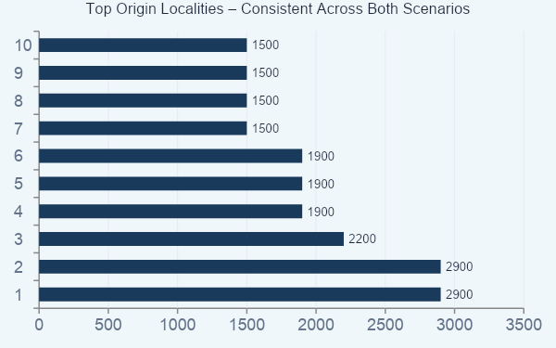
Results: Spatial Distribution
Stable Origins
San Pawl il-Bahar & Birkirkara dominate both scenarios driven by population, not purpose
Shifting Destinations
Birkirkara drops from 4.2k to 3.3k as workplace trips reduce in 4-day week
Broader Spread
4-day week destinations spread more evenly toward recreation & social localities
Gozo Low Density
The four-day week redistributes the CHARACTER of travel,
not its geography or overall volume
Gozo consistently light across both maps, smaller population, relative isolation

Slide 11
Key Findings & Conclusion
✓
Commuting drops ~50% at 0.50 retention — replaced by recreation and leisure trips
✓
Morning peak remains unchanged — leisure trips fill the same time slots
✓
Private vehicle use barely shifts — structural car dependency persists (83.4% → 82%)
✓
Geographic distribution is stable — origins driven by population, not work policy
✓
4-day week redistributes trip purposes, not total travel volume
Future Work: Person-level simulation • Sector-specific adoption rates • Induced demand modelling • Malta pilot validation

